Slide 1
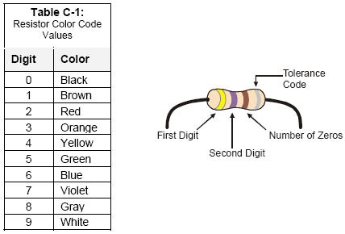
Select Resistors
Find the 470Ω and the 10kΩ resistors from your Boe-Bot kit.
Example: 470Ω resistor:
4 = yellow
7 = violet
Add 1 zero to 47 to make 470, so 1 = brown
So, 470 = yellow, violet, brown
Now, find the 10kΩ resistor.
Diagram from the Parallax Robotics book

Slide 2
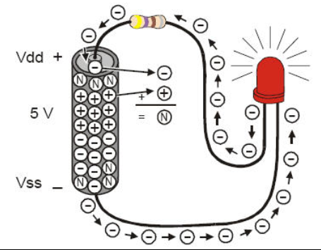
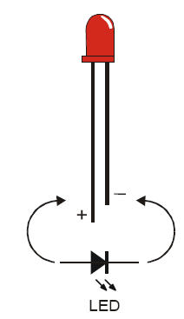
Connecting an LED
LED = Light Emitting Diode
Diagram from the Parallax Robotics book
Electricity can only flow one way through an LED (or any diode).

Slide 3
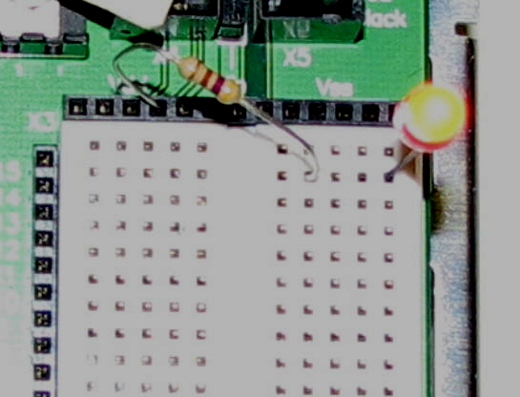
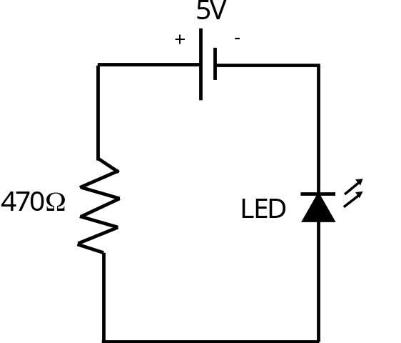
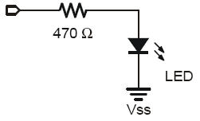
Building an LED Circuit
Vdd =
LED
These circuit diagrams
are equivalent
these holes are “connected”
Vdd = 5V
holes in this direction are not connected
Diagram from the Parallax Robotics book

Slide 4
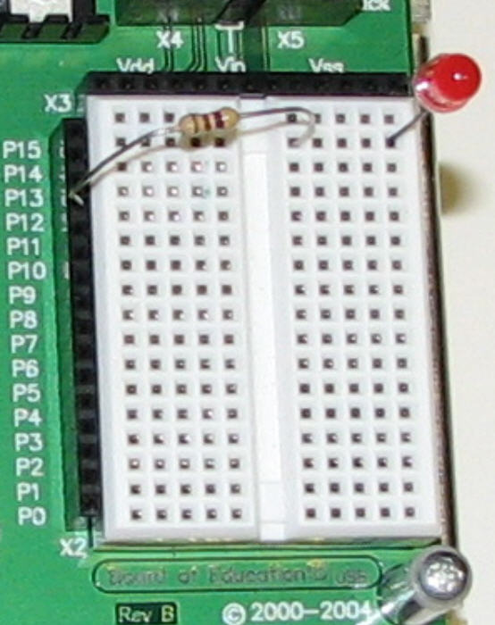
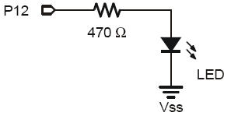
Connect the Resistor to Pin 12 (P12)
Diagram from the Parallax Robotics book
Enter and run the following PBASIC program:
' {$STAMP BS2}
' {$PBASIC 2.5}
DO
HIGH 12
PAUSE 500
LOW 12
PAUSE 500
LOOP

Slide 5
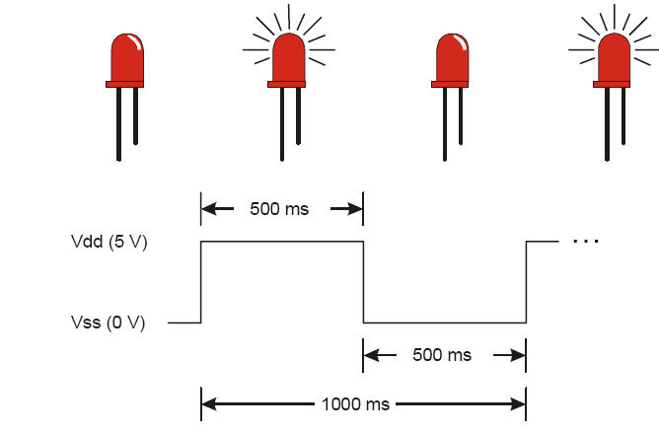
How the Program Works
' {$STAMP BS2}
' {$PBASIC 2.5}
DO
HIGH 12
PAUSE 500
LOW 12
PAUSE 500
LOOP
Causes pin 12 to output a constant 5V (Vdd)
infinite loop
wait 500 ms
Causes pin 12 to output a constant 0V (Vss)
Wait 500 ms
Diagram from the
Parallax Robotics book
HIGH = 5V and LOW = 0V (Always!!!!)

